Slide 1
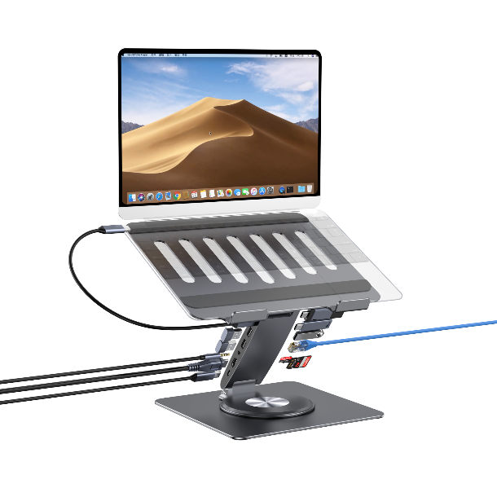

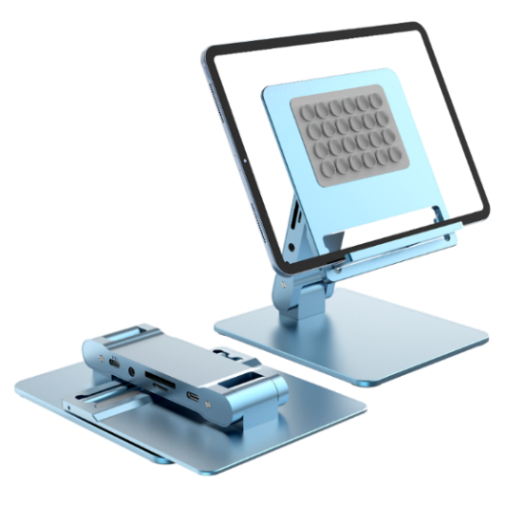
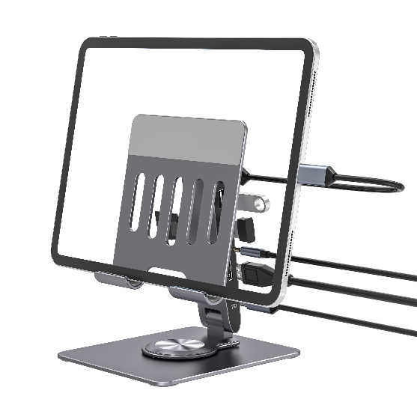

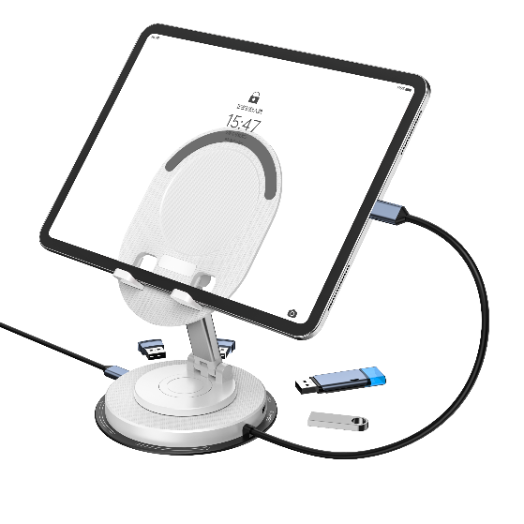
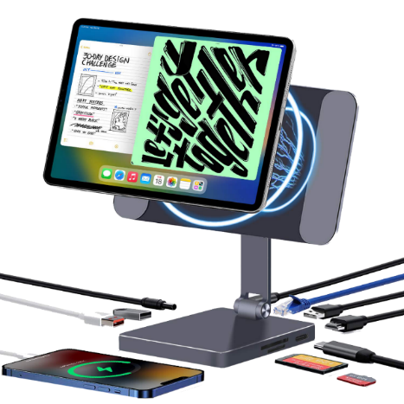
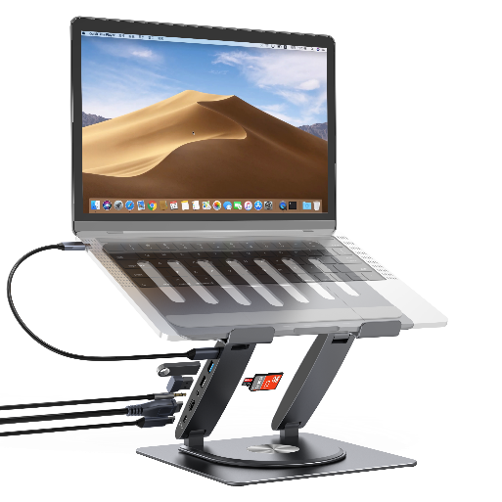

Do the best
Shenzhen Hanchen Technology Co., Ltd
Add：8-1506, Building 8-9, Xingji Home, Hongxing Community,
Songgang Street, Bao'an District, Shenzhen，China
www.szhanchen.com

Slide 2
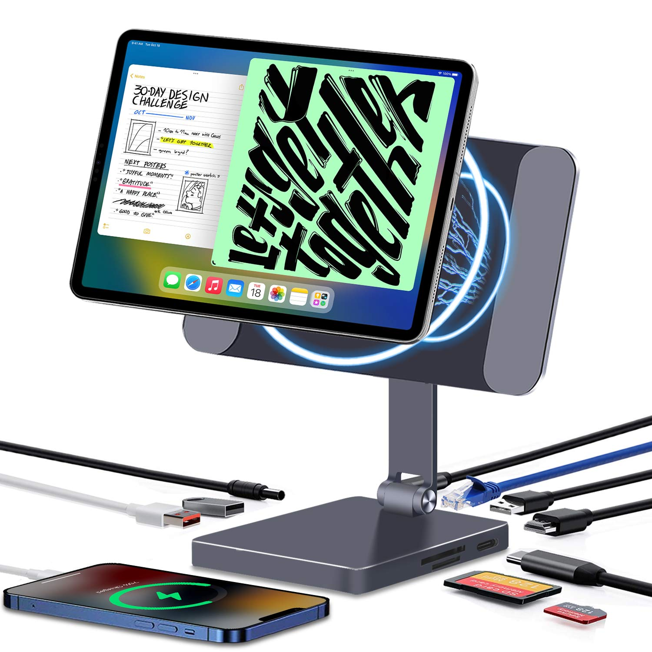
Company | Hanchen Technology
Name | iPad Magnetic HUB Stand
Color | Grey, Silver
Model | IP200
Description | Specification: Material: aluminum alloy Size: 248.5*245.6*41mm Product weight (bare):785g Hub interface (9in1): 1*HOST(10G) 1*PD(100W) 2*USB-A3.1(10G) 1*USB-A2.0 1*RJ45 1*Audio. 1*SD/TF 1*HDMI(4K60HZ) Advantages: Magnet adsorption, super stable after the tablet is placed Tablet 360 degrees easily arbitrary rotation Tablet to expand more interfaces, instantly become a computer Tablet model: 8-inch iPad mini8 11-inch iPad Pro2021\2020\2018, iPad Air4 12.9-inch iPad Pro2021\2020\2018 Notes: Including Line and Package
Remark

Slide 3
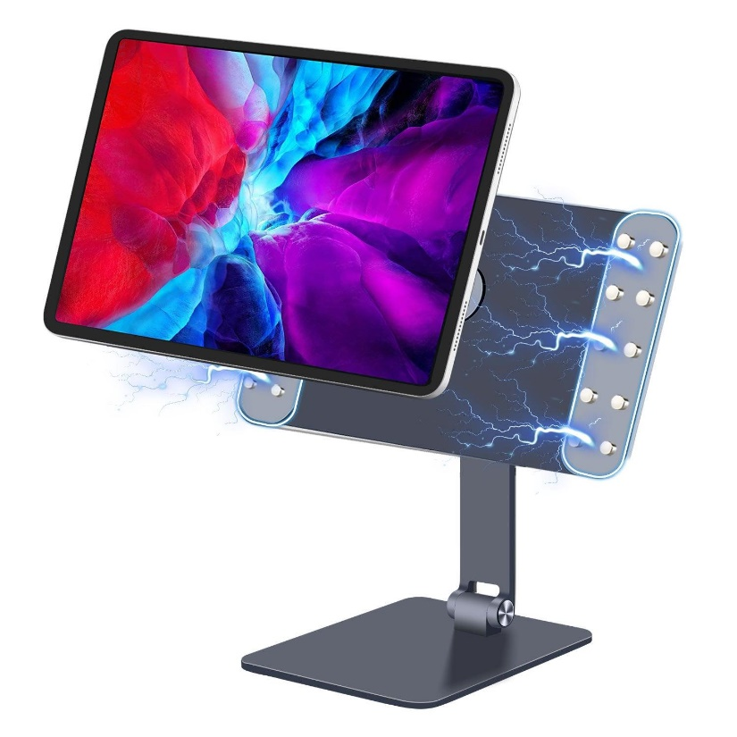
Company | Hanchen Technology
Name | iPad Magnetic Stand
Color | Grey, Silver
Model | IP100
Description | Specification: Material: aluminum alloy Size: 248.5*245.6*31.3mm Product weight (bare):715g Advantages: Firm and stable Free stop hinge, arbitrary stop Magnet adsorption, super stable after the tablet is placed 180-degree folding, easy to store, easy to carry Tablet 360 degrees easily arbitrary rotation Tablet models: iPad mini8 11inch iPad Pro2021/2020/2018, iPad Air4 12.9 inch iPad Pro2021/2020/2018 Notes: Including Package
Remark

Slide 4
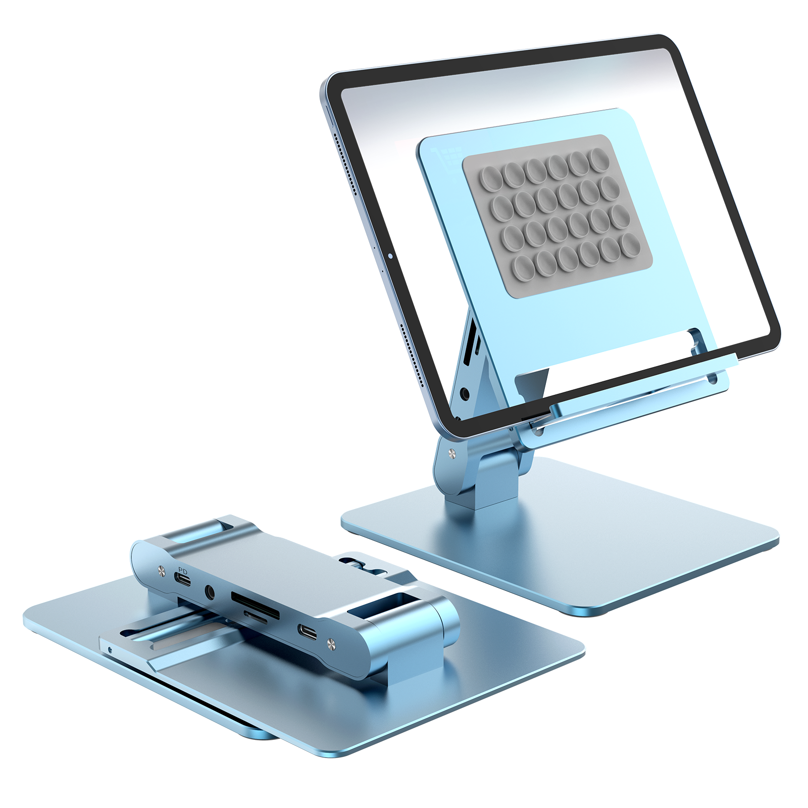
Company | Hanchen Technology
Name | Tablet HUB Stand
Color | Grey, Silver, Blue
Model | P200A
Description | Specification: Material: aluminum alloy Size: 173*120*29mm Product weight (bare):445g Hub interface (8in1): 1*HOST(5G) 1*PD(100W) 2*USB-A3.0(5G) 1*USB-C3.0.(5G) 1*Audio. 1*SD/TF 1*HDMI(4K30HZ) Advantages: Firm and stable Free stop hinge, arbitrary stop Silicone adsorption, super stable after the tablet is placed 180 degree folding, easy to store, easy to carry Recommended tablet size: 4-13 inches Tablet instantly becomes a computer Notes: Including Line and Package Suitable for Smart phone/Tablet/Laptop
Remark

Slide 5
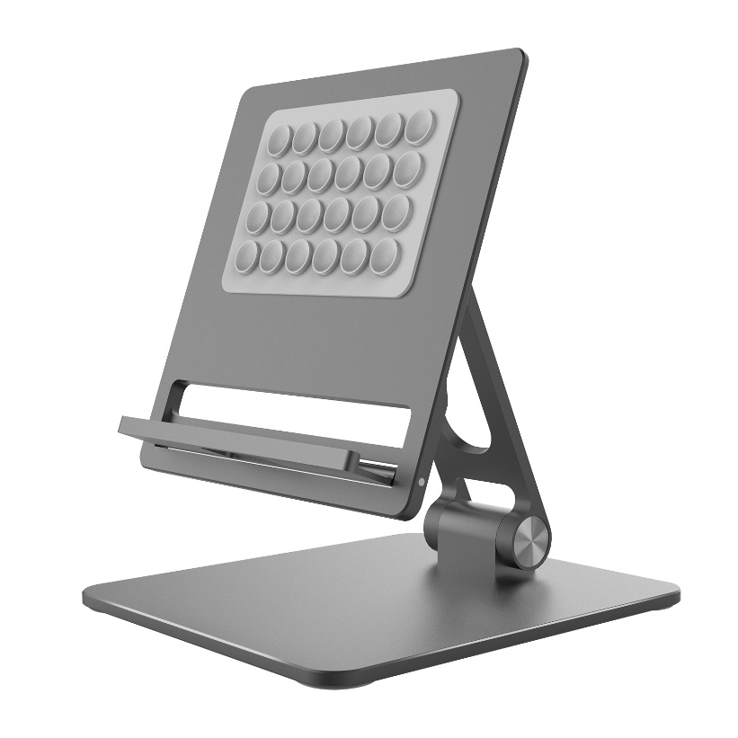
Company | Hanchen Technology
Name | Tablet Stand
Color | Grey, Silver, Blue
Model | P100A
Description | Specification: Material: aluminum alloy Size: 173*120*29mm Product weight(bare):375g Advantages: Firm and stable Free stop hinge, arbitrary stop Silicone adsorption, super stable after the tablet is placed 180 degree folding, easy to store, easy to carry Recommended tablet size: 4-13 inches Notes: Including Package
Remark

Slide 6
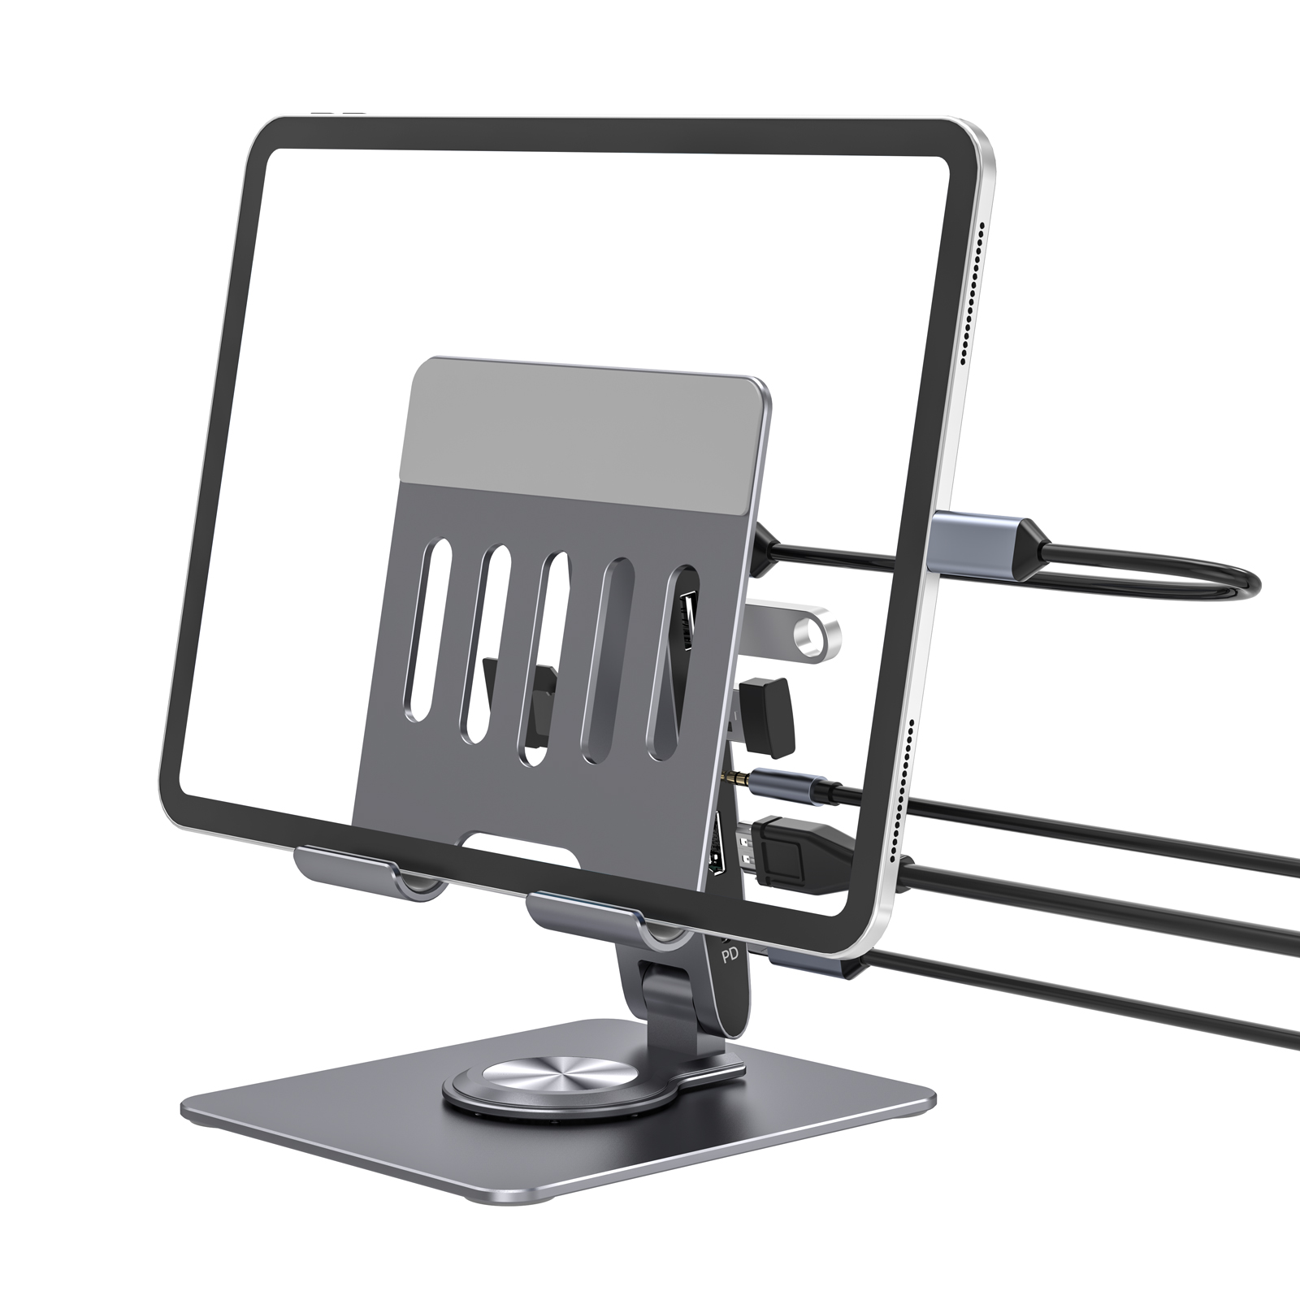
Company | Hanchen Technology
Name | Tablet HUB Stand
Color | Grey, Silver
Model | PR100B
Description | Specification: Material: aluminum alloy Size: 178*120*53mm Product weight (bare):372g Hub interface (7in1): 1*HOST(5G) 1*PD(100W） 1*USB-A3.0(5G） 1*USB-A2.0 1*HDMI(4K30HZ) 1*Audio 1*SD/TF Advantages: Free stop hinge, arbitrary stop 180 degree folding, easy to store, easy to carry Flat 360 degree rotation, easy any view Smart phone/Tablet/Laptop expand more interfaces Tablet instantly becomes a computer Notes: Including Line and Package Suitable for Smart phone/Tablet/Laptop
Remark

Slide 7
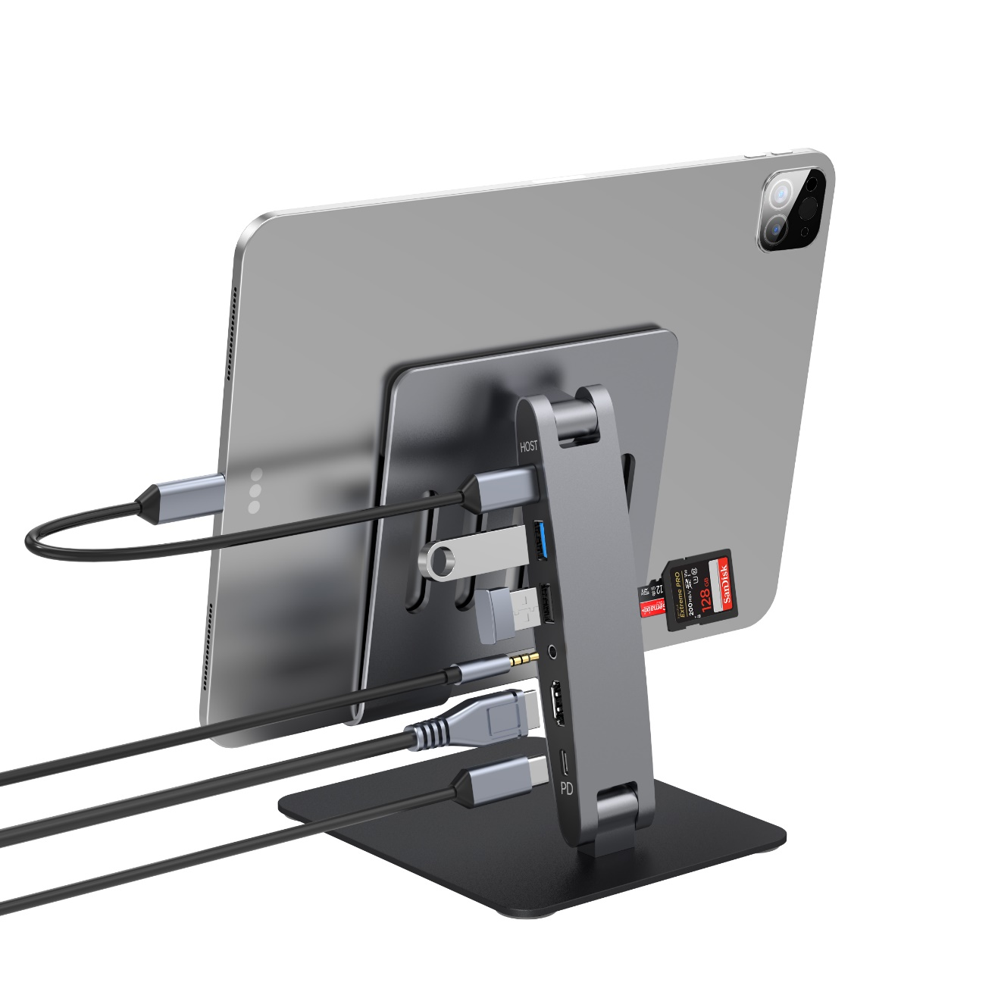
Company | Hanchen Technology
Name | Tablet HUB Stand
Color | Grey, Silver
Model | P100B
Description | Specification: Material: aluminum alloy Size: 178*120*48.2mm Product weight (bare):532g Hub interface (7in1): 1*HOST(5G) 1*PD(100W） 1*USB-A3.0(5G） 1*USB-A2.0 1*HDMI(4K30HZ) 1*Audio 1*SD/TF Advantages: Free stop hinge, arbitrary stop 180 degree folding, easy to store, easy to carry Smart phone/Tablet/Laptop expand more interfaces Tablet instantly becomes a computer Notes: Including Line and Package Suitable for Smart phone/Tablet/Laptop
Remark

Slide 8
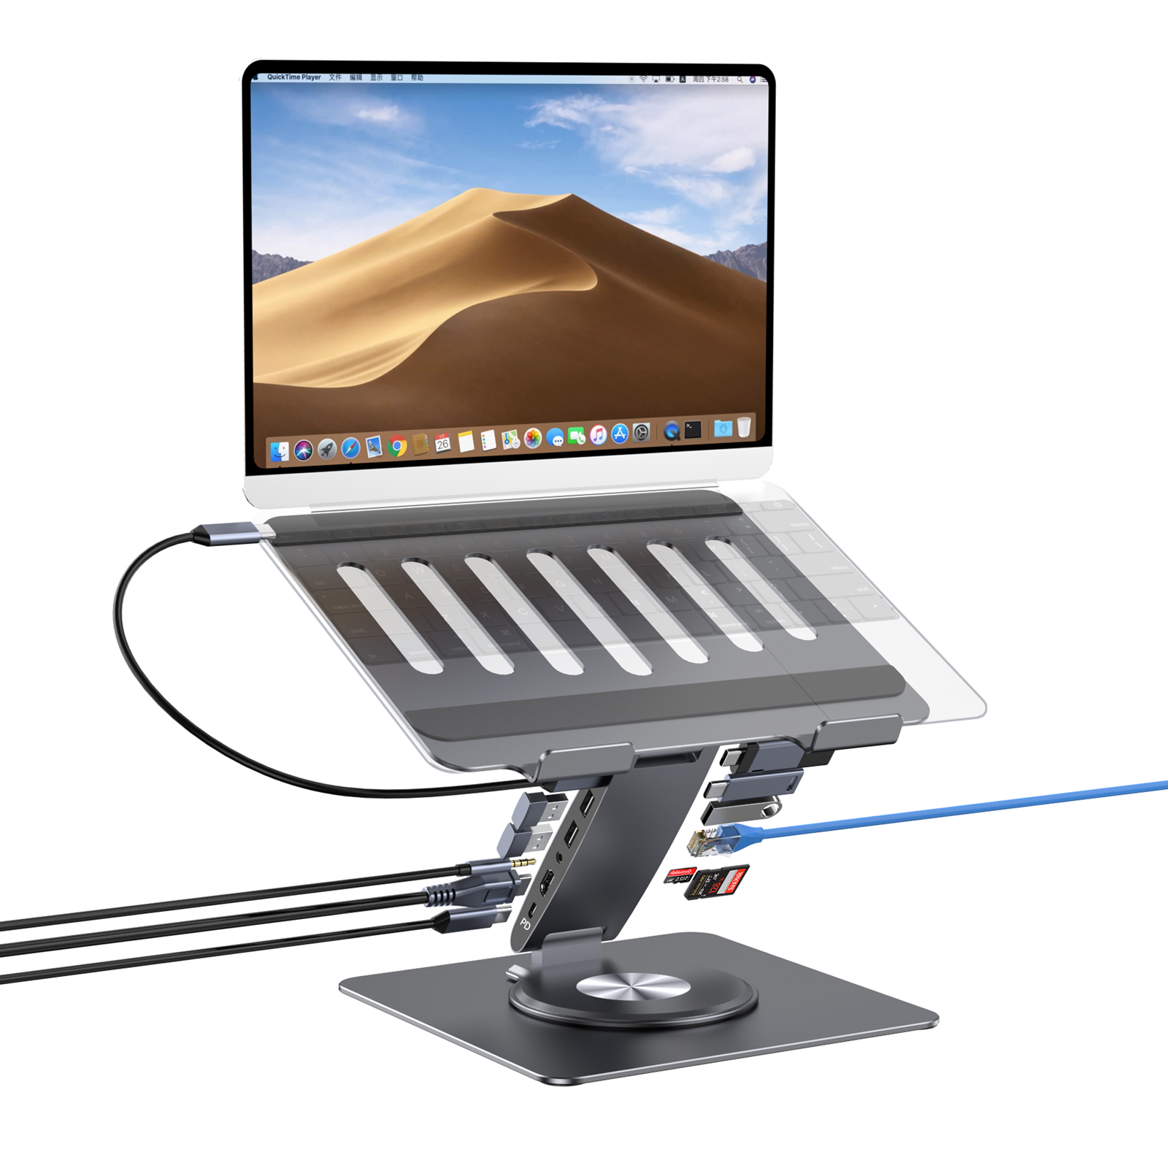
Company | Hanchen Technology
Name | Laptop HUB Stand
Color | Grey, Silver
Model | PCR100D
Description | Specification: Material: aluminum alloy Size: 250*212.5*48mm Product weight (bare):950g Hub interface (11in1): 1*HOST(5G) 1*PD(100W) 1*USB-A3.0(5G) 2*USB-A2.0 2*USB-C3.0(5G) 1*Audio 1*SD/TF 1*RJ45 1*HDMI(4K30HZ) Advantages: Free stop hinge, arbitrary stop 180 degree folding, easy to store, easy to carry Flat 360 degree rotation, easy any view Tablet / Laptop expand more interfaces Notes: Including Line and Package Suitable for Tablet/Laptop
Remark

Slide 9
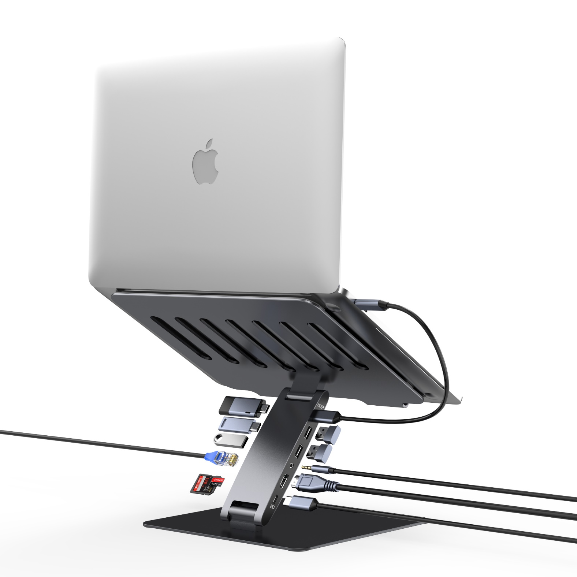
Company | Hanchen Technology
Name | Laptop HUB Stand
Color | Grey, Silver
Model | PC100D
Description | Specification: Material: aluminum alloy Size: 250*212.5*42mm Product weight (bare):g Hub interface (11in1): 1*HOST(5G) 1*PD(100W) 1*USB-A3.0(5G) 2*USB-A2.0 2*USB-C3.0(5G) 1*Audio 1*SD/TF 1*RJ45 1*HDMI(4K30HZ) Advantages: Free stop hinge, arbitrary stop 180 degree folding, easy to store, easy to carry Tablet / Laptop expand more interfaces Notes: Including Line and Package Suitable for Tablet/Laptop
Remark

Slide 10
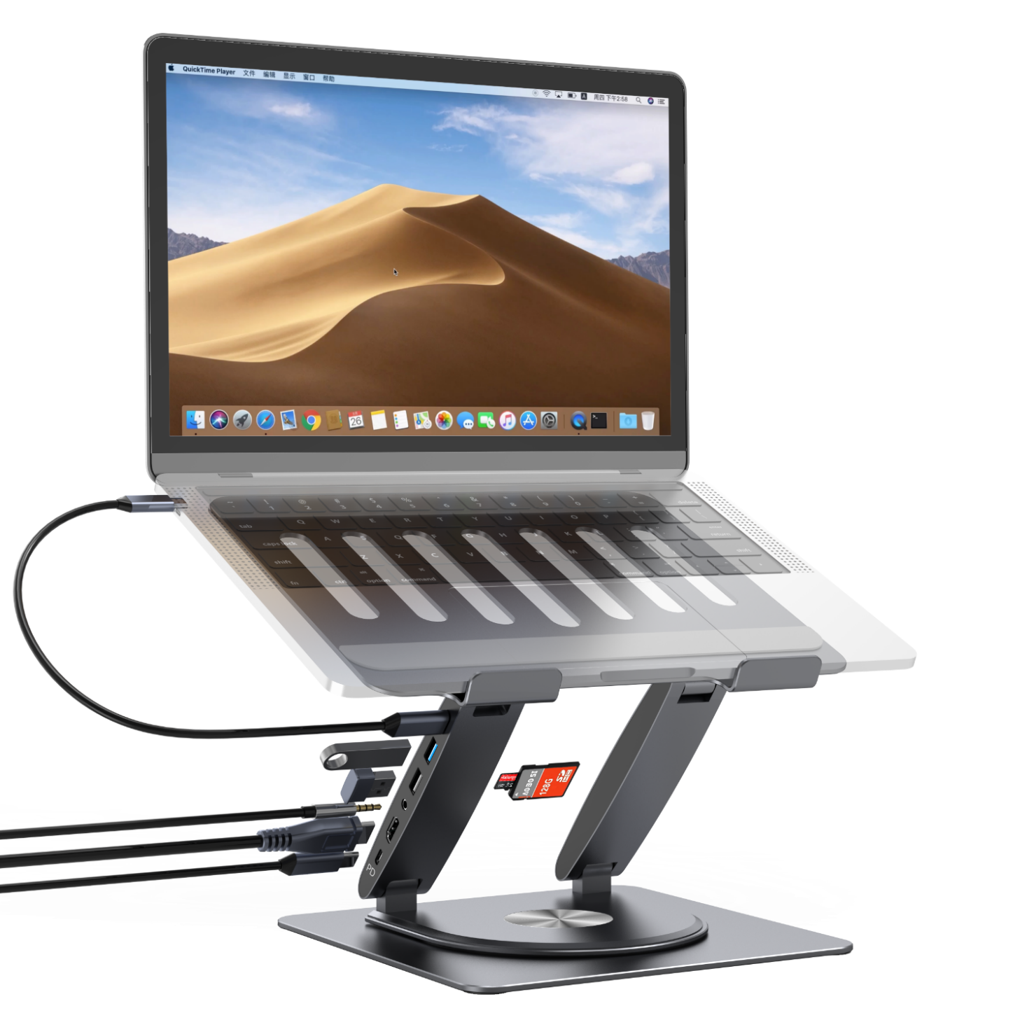
Company | Hanchen Technology
Name | Laptop HUB Stand
Color | Grey, Silver
Model | PCR100B
Description | Specification： Material: aluminum alloy Size: 250*212.5*48mm Product weight (bare):1g Hub interface (7in1)： 1*HOST(5G) 1*PD(100W） 1*USB-A3.0(5G） 1*USB-A2.0 1*HDMI(4K30HZ) 1*Audio 1*SD/TF Advantages: Free stop hinge, arbitrary stop 180 degree folding, easy to store, easy to carry Flat 360 degree rotation, easy any view Tablet / Laptop expand more interfaces Notes: Including Line and Package Suitable for Tablet/Laptop
Remark

Slide 11
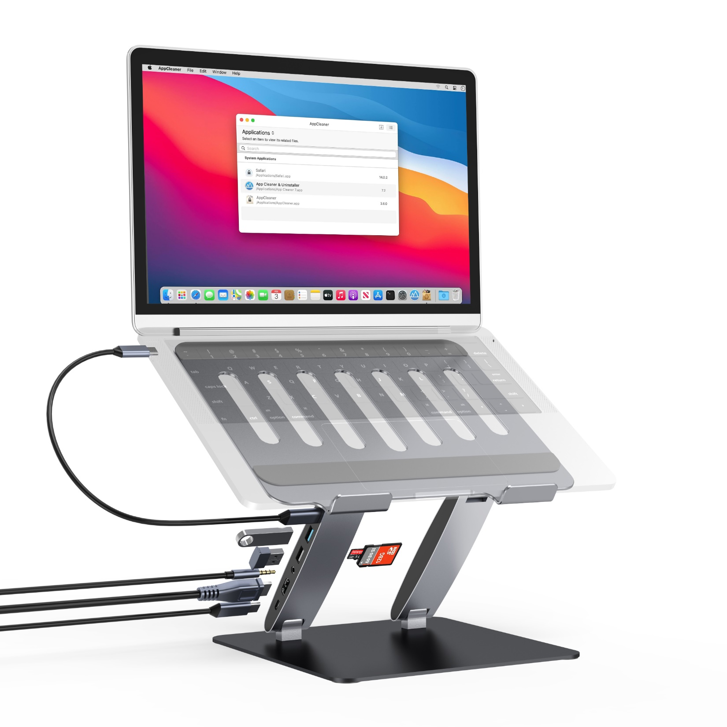
Company | Hanchen Technology
Name | Laptop HUB Stand
Color | Grey, Silver
Model | PC100B
Description | Specification： Material: aluminum alloy Size: 250*212.5*42mm Product weight (bare):g Hub interface (7in1)： 1*HOST(5G) 1*PD(100W） 1*USB-A3.0(5G） 1*USB-A2.0 1*HDMI(4K30HZ) 1*Audio 1*SD/TF Advantages: Free stop hinge, arbitrary stop 180 degree folding, easy to store, easy to carry Tablet / Laptop expand more interfaces Notes: Including Line and Package Suitable for Tablet/Laptop
Remark

Slide 12
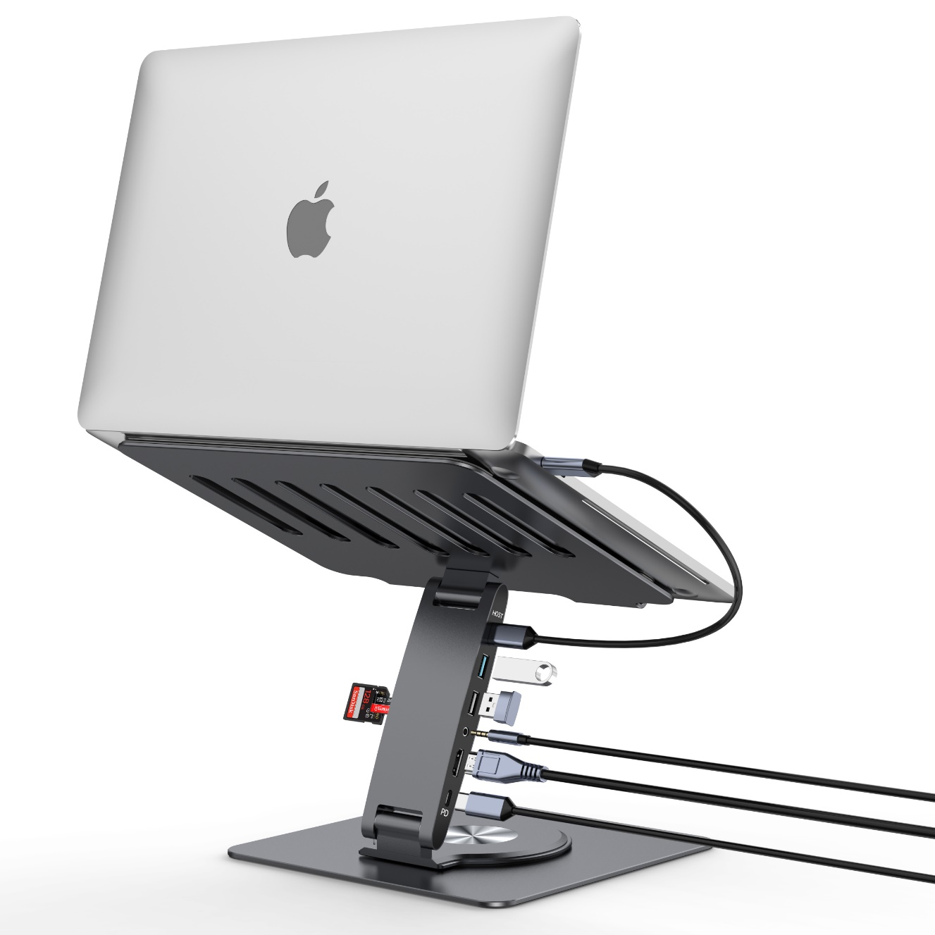
Company | Hanchen Technology
Name | Laptop HUB Stand
Color | Grey, Silver
Model | PCR100E
Description | Specification: Material: aluminum alloy Size: 250*212.5*48mm Product weight (bare):950g Hub interface (11in1): 1*HOST(5G) 1*PD(100W） 1*USB-A3.0(5G） 1*USB-A2.0 1*HDMI(4K30HZ) 1*Audio 1*SD/TF Advantages: Free stop hinge, arbitrary stop 180 degree folding, easy to store, easy to carry Flat 360 degree rotation, easy any view Tablet / Laptop expand more interfaces Notes: Including Line and Package Suitable for Tablet/Laptop
Remark

Slide 13
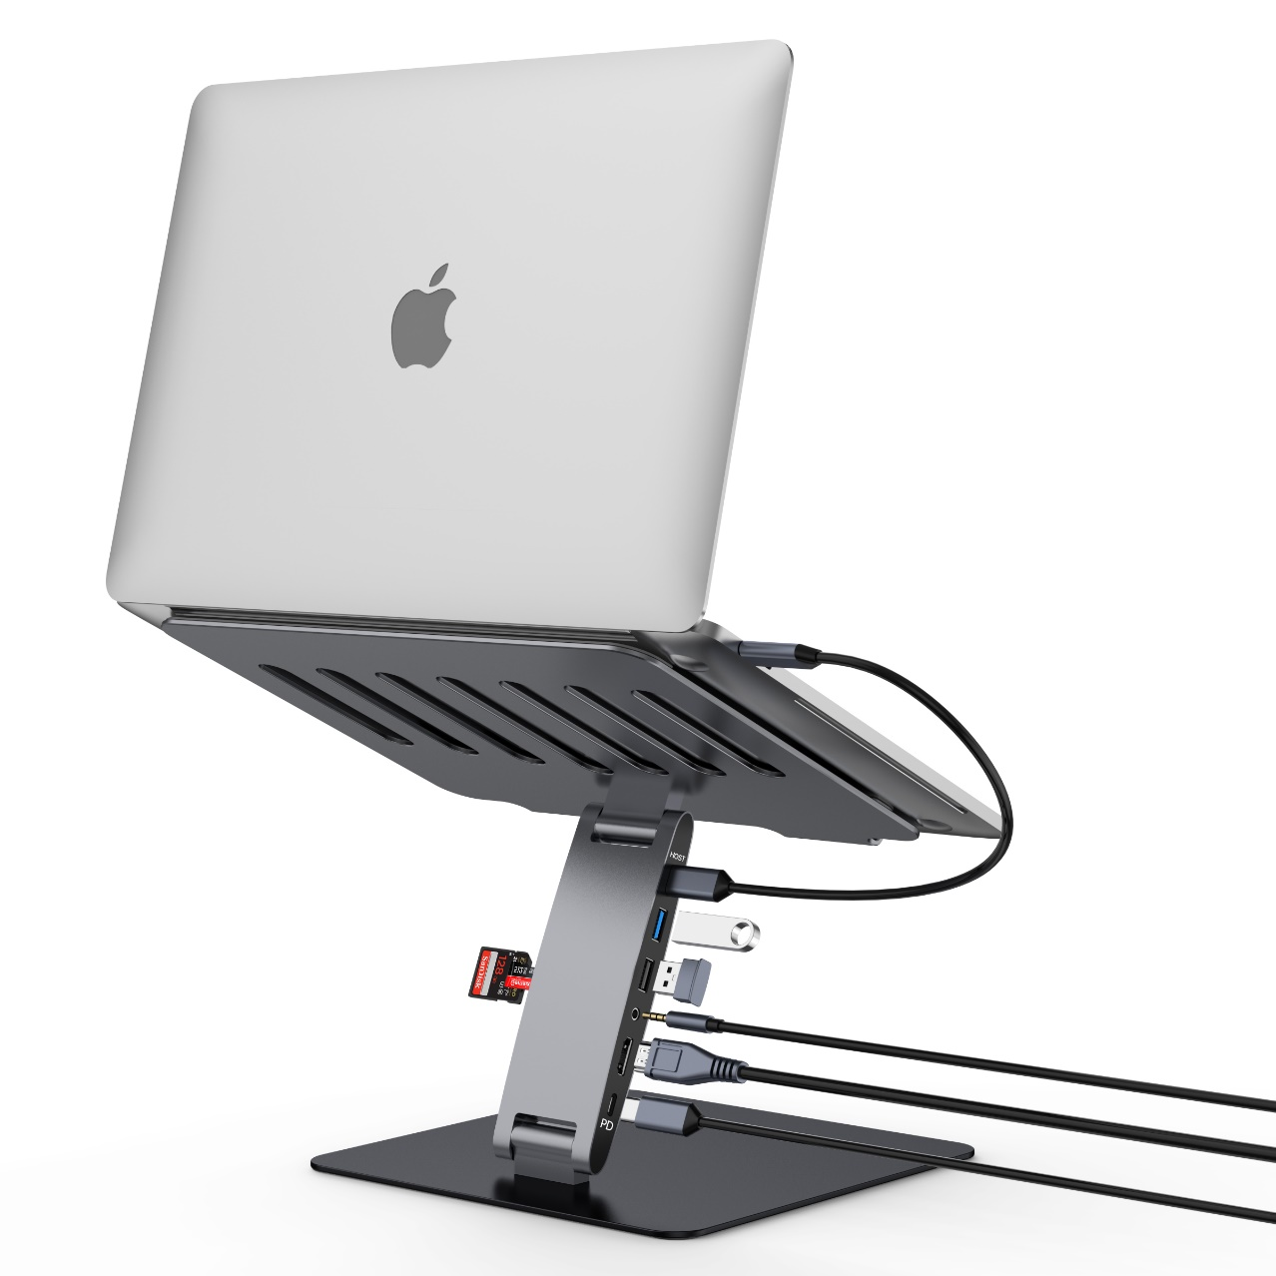
Company | Hanchen Technology
Name | Laptop HUB Stand
Color | Grey, Silver
Model | PC100E
Description | Specification: Material: aluminum alloy Size: 250*212.5*42mm Product weight (bare):g Hub interface (11in1): 1*HOST(5G) 1*PD(100W） 1*USB-A3.0(5G） 1*USB-A2.0 1*HDMI(4K30HZ) 1*Audio 1*SD/TF Advantages: Free stop hinge, arbitrary stop 180 degree folding, easy to store, easy to carry Tablet / Laptop expand more interfaces Notes: Including Line and Package Suitable for Tablet/Laptop
Remark

Slide 14
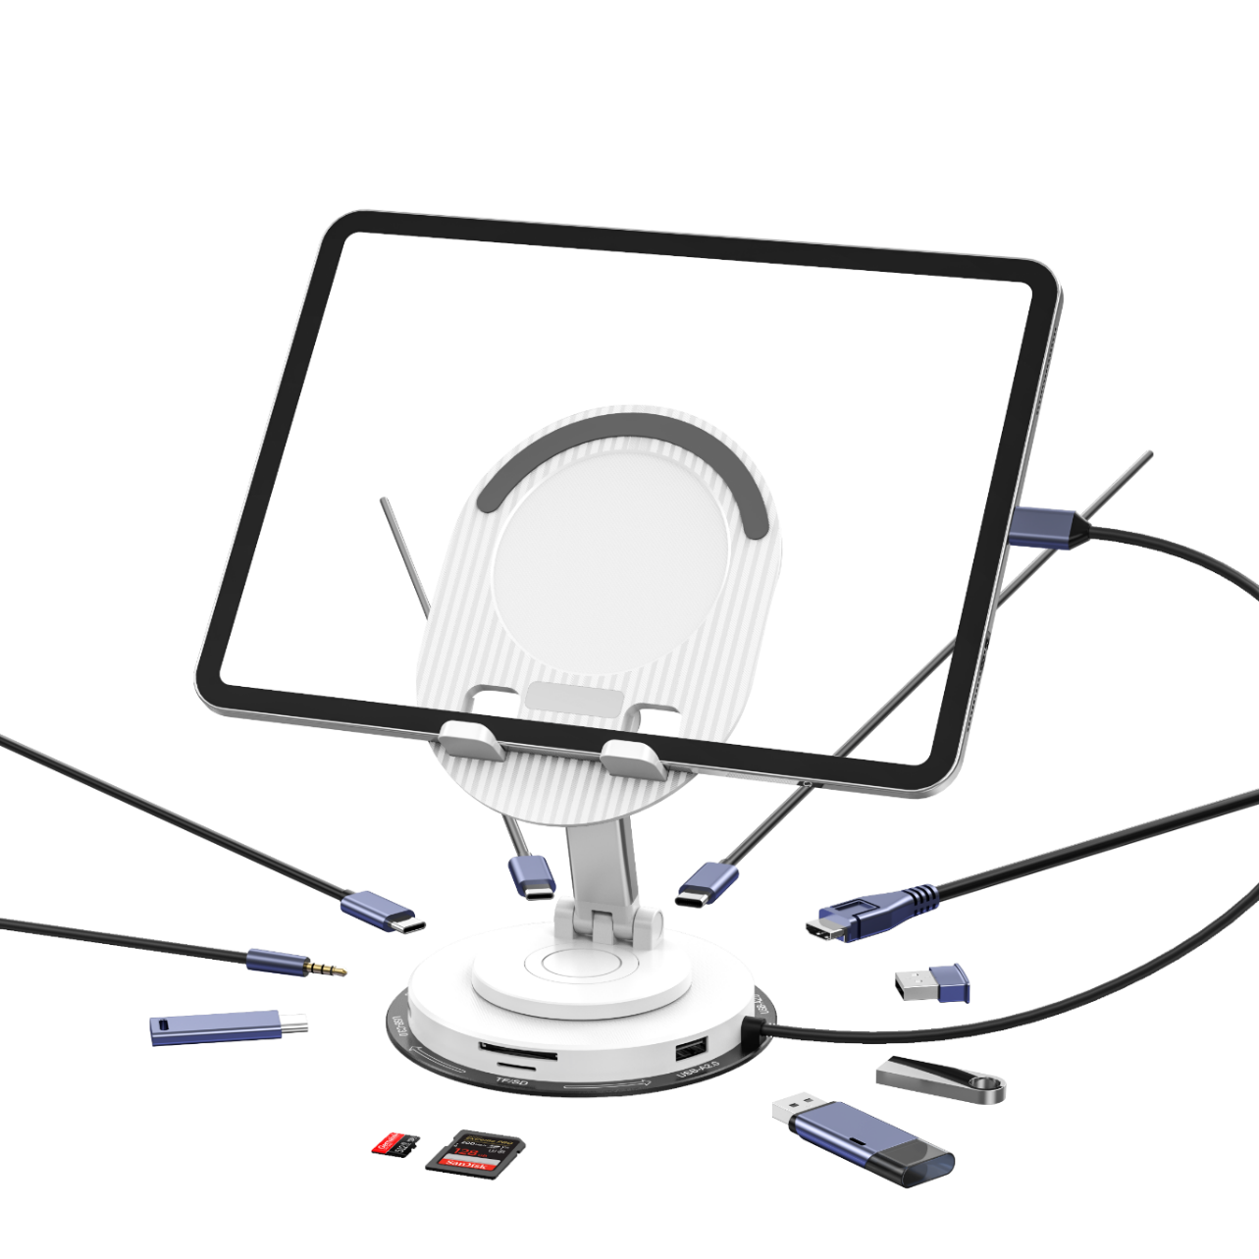
Company | Hanchen Technology
Name | Smart Phone\Tablet HUB Stand
Color | White, Black
Model | PR200C
Description | Specification: Material: Metal + Plastic + Aluminum alloy Size: 142*122*38.2mm Product weight (bare):g Hub interface (10in1): 1*HOST(5G) 1*PD(100W） 1*USB-A3.0(5G） 2*USB-A2.0 2*USB-C3.0(5G） 1*Audio 1*SD/TF 1*HDMI(4K30HZ) Advantages: 180 degree folding, easy to store, easy to carry Flat 360 degree rotation, easy any view Smart phone/Tablet/Laptop expand more interfaces Tablet instantly becomes a computer Notes: Including Line and Package Suitable for Smart phone/Tablet/Laptop
Remark

Slide 15
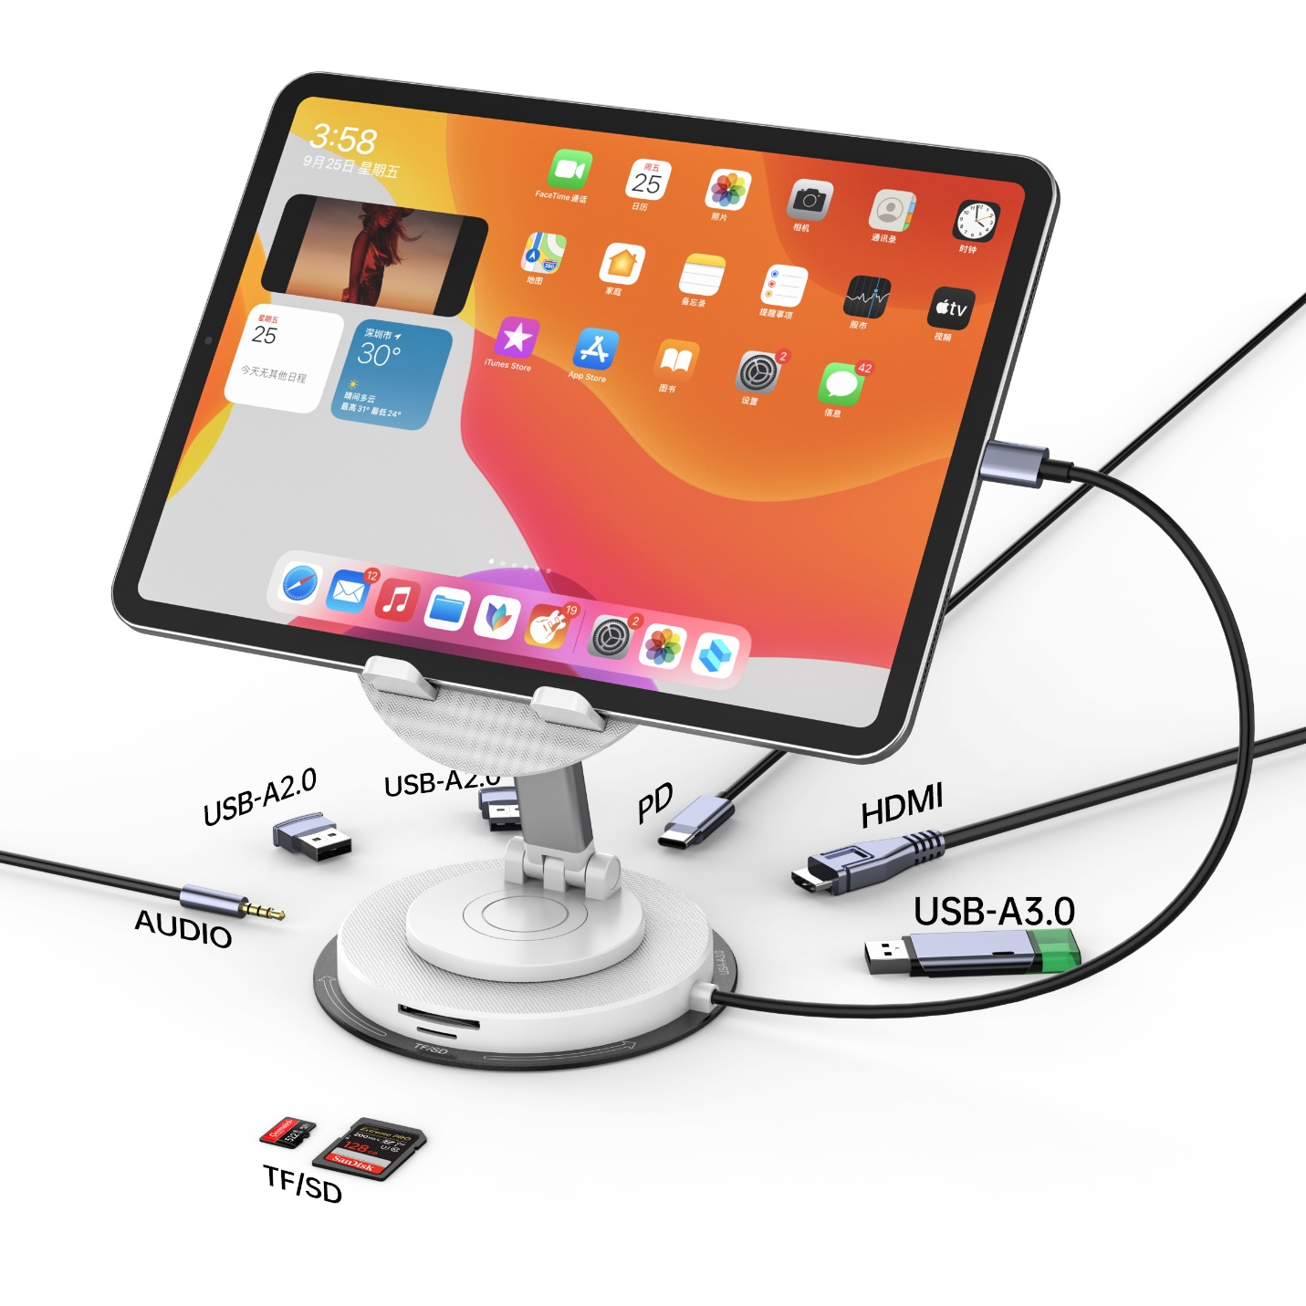
Company | Hanchen Technology
Name | Smart Phone\Tablet HUB Stand
Color | White, Black
Model | PR200D
Description | Specification: Material: Metal + Plastic + Aluminum alloy Size: 142*122*38.2mm Product weight (bare):g Hub interface (8in1): 1*HOST(5G) 1*PD(100W） 1*USB-A3.0(5G） 2*USB-A2.0 1*HDMI(4K30HZ) 1*Audio 1*SD/TF Advantages: 180 degree folding, easy to store, easy to carry Flat 360 degree rotation, easy any view Smart phone/Tablet/Laptop expand more interfaces Tablet instantly becomes a computer Notes: Including Line and Package Suitable for Smart phone/Tablet/Laptop
Remark

Slide 16

Company | Hanchen Technology
Name | Smart Phone\Tablet HUB Stand
Color | White, Black
Model | PR200B
Description | Specification: Material: Metal + Plastic + Aluminum alloy Size: 142*122*38.2mm Product weight (bare):g Hub interface (5in1): 1*HOST(5G) 1*PD(100W） 1*USB-A3.0(5G） 3*USB-A2.0 Advantages: 180 degree folding, easy to store, easy to carry Flat 360 degree rotation, easy any view Smart phone/Tablet/Laptop expand more interfaces Tablet instantly becomes a computer Notes: Including Line and Package Suitable for Smart phone/Tablet/Laptop
Remark

Slide 17
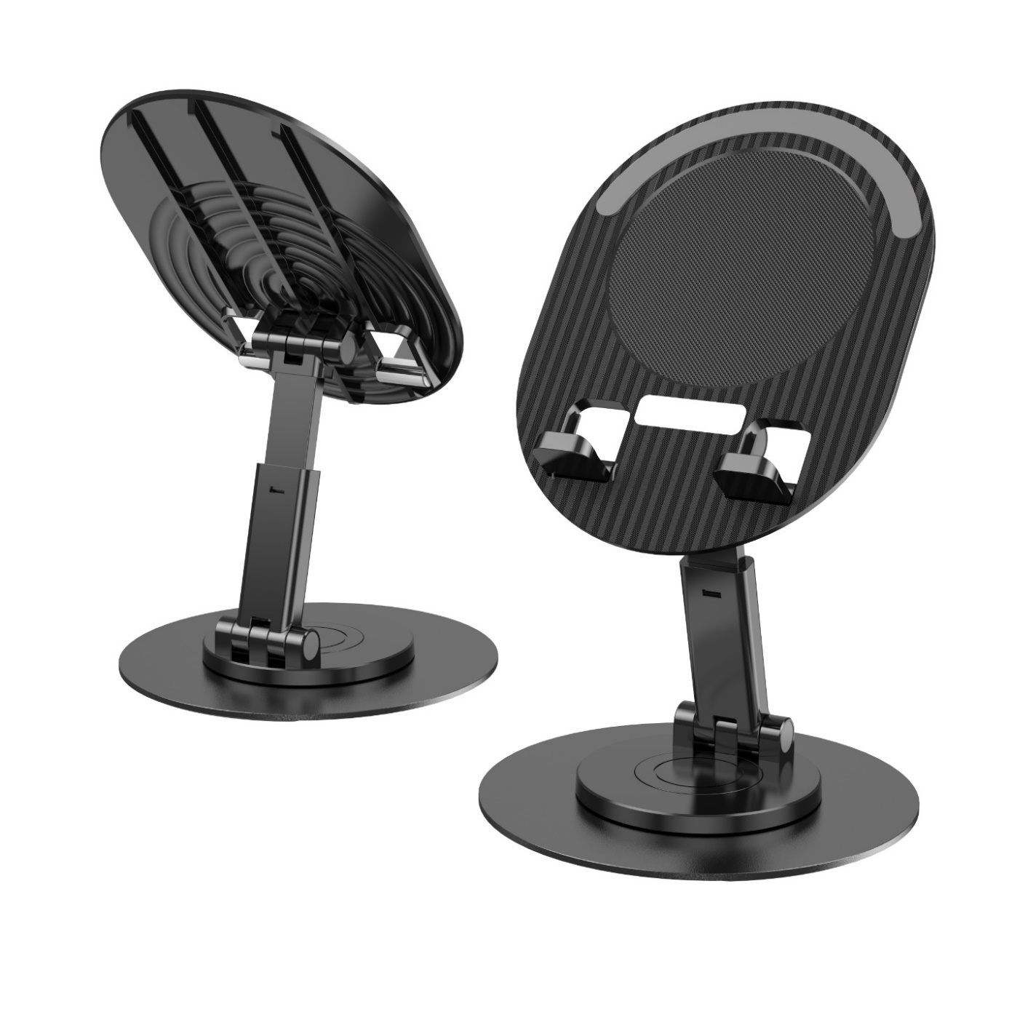
Company | Hanchen Technology
Name | Phone\Tablet Stand
Color | White, Black
Model | PR200A
Description | Specification: Material: Metal + Plastic Size: 142*122*27mm Product weight (bare):：198g Advantages: 180 degree folding, easy to store, easy to carry Flat 360 degree rotation, easy any view Notes: Including Package Suitable for Phone/Tablet
Remark

Slide 18
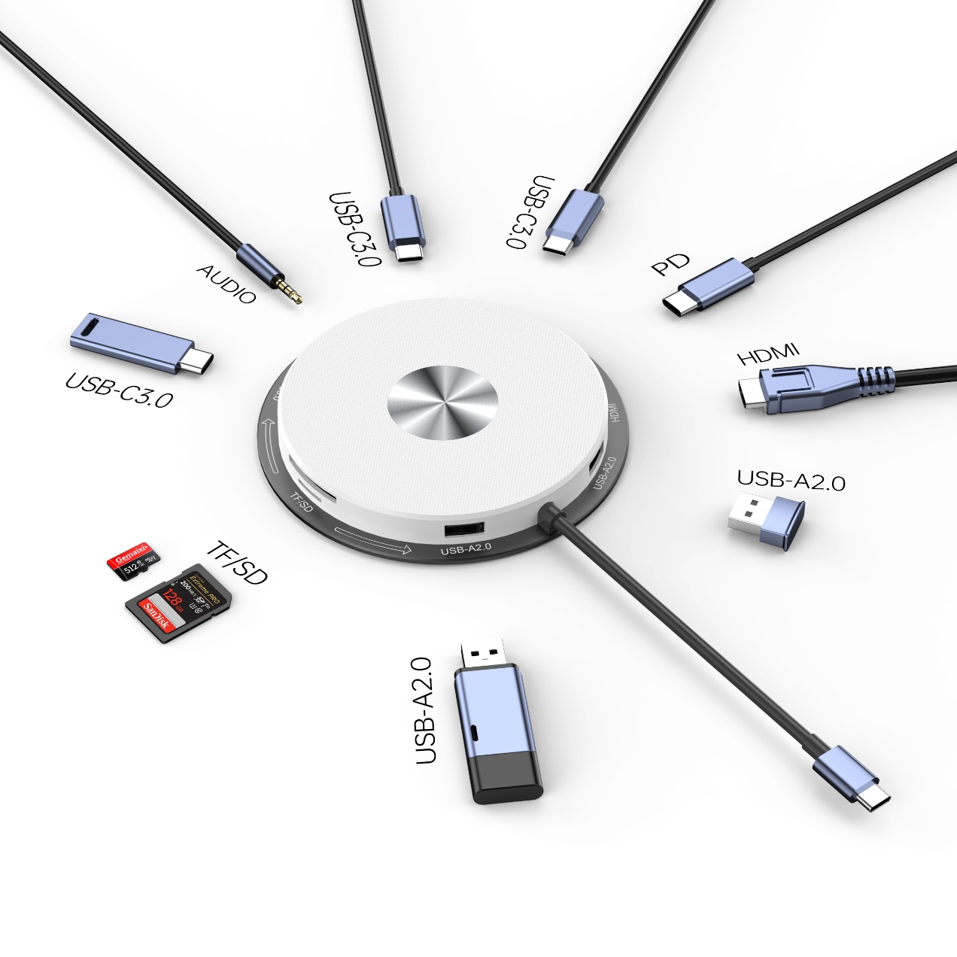
Company | Hanchen Technology
Name | HUB
Color | White, Black
Model | HUB200A
Description | Specification: Material: Metal + Plastic Size: 122*122*14.5mm Product weight (bare):255g Hub interface (10in1): 1*HOST(5G) 1*PD(100W） 1*USB-A3.0(5G） 2*USB-A2.0 2*USB-C3.0(5G） 1*Audio 1*SD/TF 1*HDMI(4K30HZ) Advantages: Simplicity, lightness and portability Smart phone/Tablet/Laptop expand more interfaces Notes: Including Line and Package Suitable for Smart phone/Tablet/Laptop
Remark

